Slide 1


E-Commerce Website for Bhagirathi Book Store

Slide 2

GROUP MEMBERS:
Online Book Store is created by a group of 6TH semester students of CST department as a major project .
Sukanya Sarkar
Quazi Adnan Haque
Prithwish Mondal
Kuyasha Kar
Tanmay Roy
Rabiul Rahaman
Souvick Ghosh
Dipu Roy
Anoy Dutta

Slide 3

Index
Entity Relationship Diagram
Flowchart
Data Dictionary
Screen Shot
Advantages & Disadvantages
Future Scope
Conclusion
Thank You [Exit]
Definition
Project Profile
System Specification
Key Features
Risk Analysis
Modules
Data Flow Diagram

Slide 4

Definition
This is online book shopping site.
By which user can put details of books and user can search it , can be member of site, buy online books ,and see other related books of same author or same category.
User can view online book details from anywhere through internet and purchase it with payment on cash.

Slide 5

Objectives
The main objective of “Online Book Store” is to provide an essence of online book store via a simple and yet powerful medium.
The project has been designed to simulate the working of an actual online book store.

Slide 6
SYSTEM SPECIFICATION
Hardware Requirements:
Pentinum-iv(processer)
256 MB Ram
512 KB cache Memory
Hard disk 10 GB
Microsoft Compatible 101 or more key Board
Software Requirements:
Operating System: Windows
Web- technology : PHP
Front-End : HTML, CSS, JAVASCRIPT
Back-End : MySQL
Web Server : Apache Server

Slide 7
Key Features
Many types of categories are available in our site.
User can search books subject wise.
User can add books to his wish list which he wants to purchase later.
One can take information about future realising books.

Slide 8
Modules
Home Page
View book Details
Contact us
User Registration
Purchase Order
Admin
Payment

Slide 9

Home
Most popular subjects
Complete collections
Top new releases
Top authors

Slide 10

View Book
The user will be allowed to view all the books available in the book store.
The main aim of this module is to display the details about the stock details in book store.
Even though a registered as well as new user could view the books, only the registered user is allowed to purchase the book from the book store.

Slide 11

Contact us
Bulk order inquiry
Undelivered orders
Company information
Sell us new books

Slide 12
User Registration
If the user is new to the site , he/she can sign up to register by filling an online registration form.
A user id will be generated automatically. If the user is already a registered member of the site , he can open his account by simply log in .
If the user wants to purchase a particular book , he/she should have an account.

Slide 13
Purchase Order
No. of items
List of books with price
Total Amounts

Slide 14
Admin
Login form
Customer registration review page
Customer purchase order review page

Slide 15
Payment
A payment gateway is a direct payments processing.

Slide 16
DATA FLOW DIAGRAM (DFD)

Slide 17
Online shopping
user
products
DATA FLOW DIAGRAM

Slide 18

1.0
SEARCH
PRODUCTS1
USER
2.0
ORDER

Slide 19
USER
SEARCH
1.1
PRODUCTS
APPLY
FILTERS
1.2
1.3
SPECIFICATION
VIEW SPECIFICATION
REVIEWS
IMAGES

Slide 20
ADD TO CART
2.1
USER
PRODUCTS
EDIT CART
2.2
CHECK OUT
2.3

Slide 21
ENTITY RELATIONSHIP DIAGRAM(ERD)
ENTITY RELATIONSHIP DIAGRAM(ERD)

Slide 22
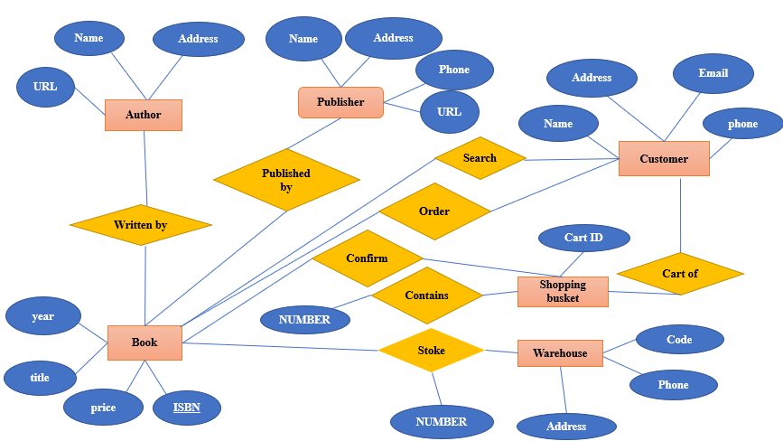

Slide 23
HOW THE PROJECT WORKS

Slide 24
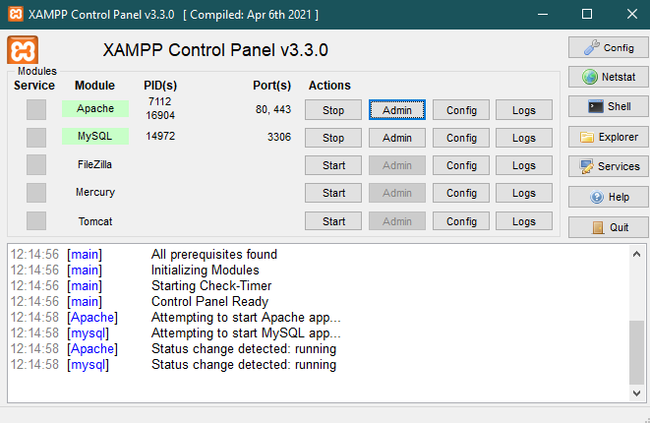

Slide 25
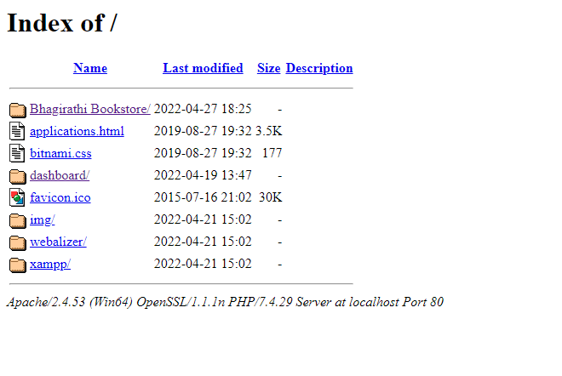

Slide 26
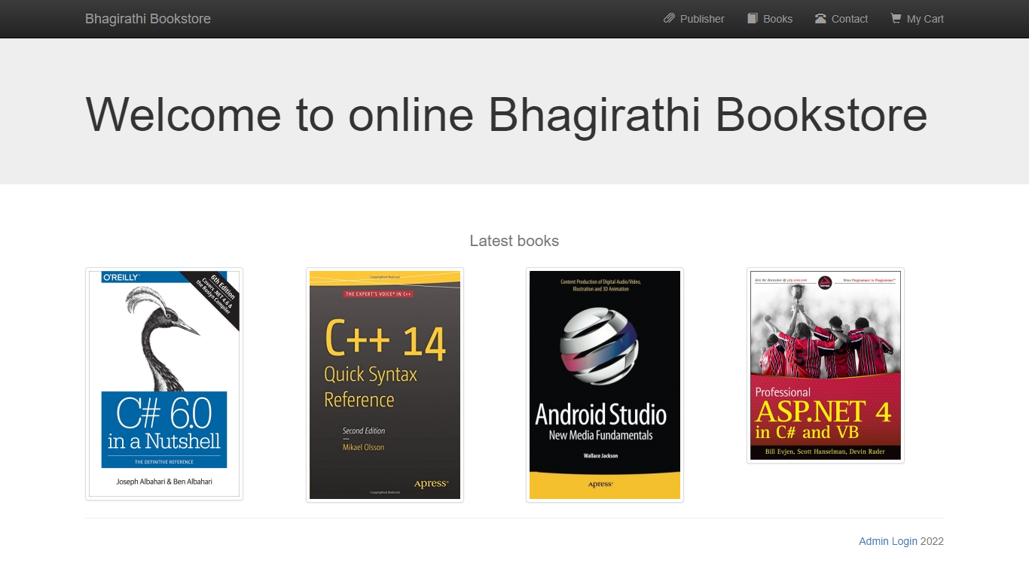

Slide 27
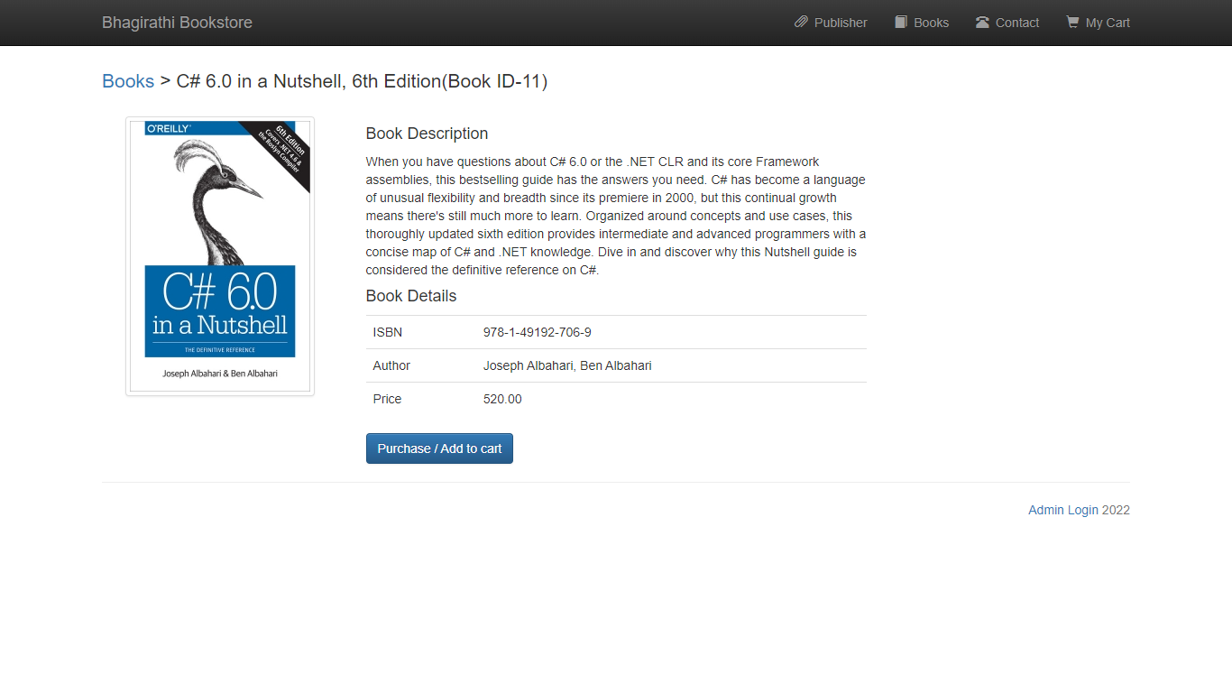

Slide 28
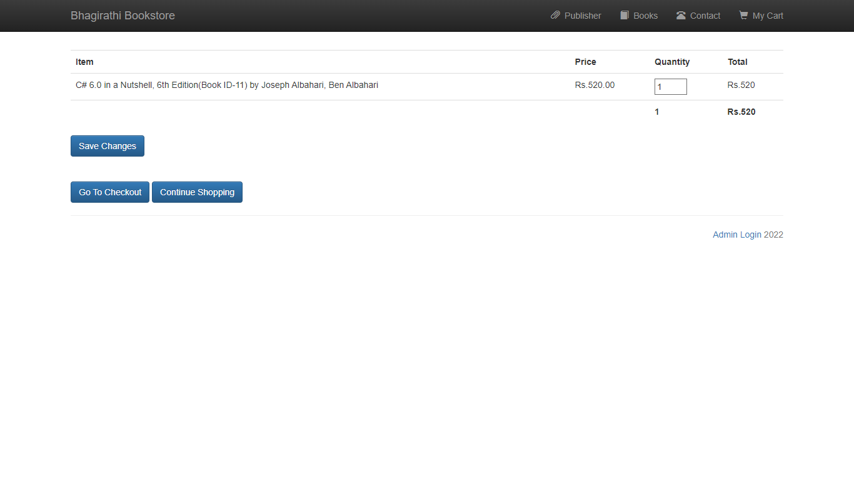

Slide 29
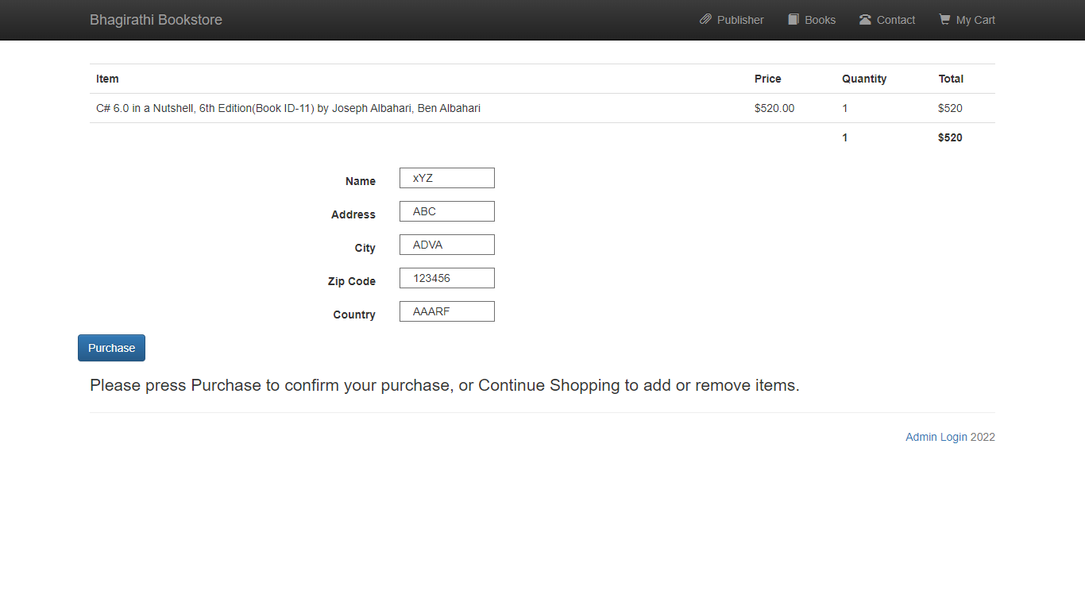

Slide 30
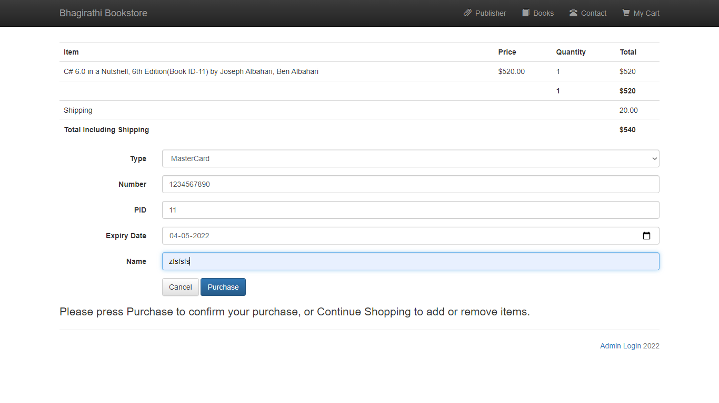

Slide 31
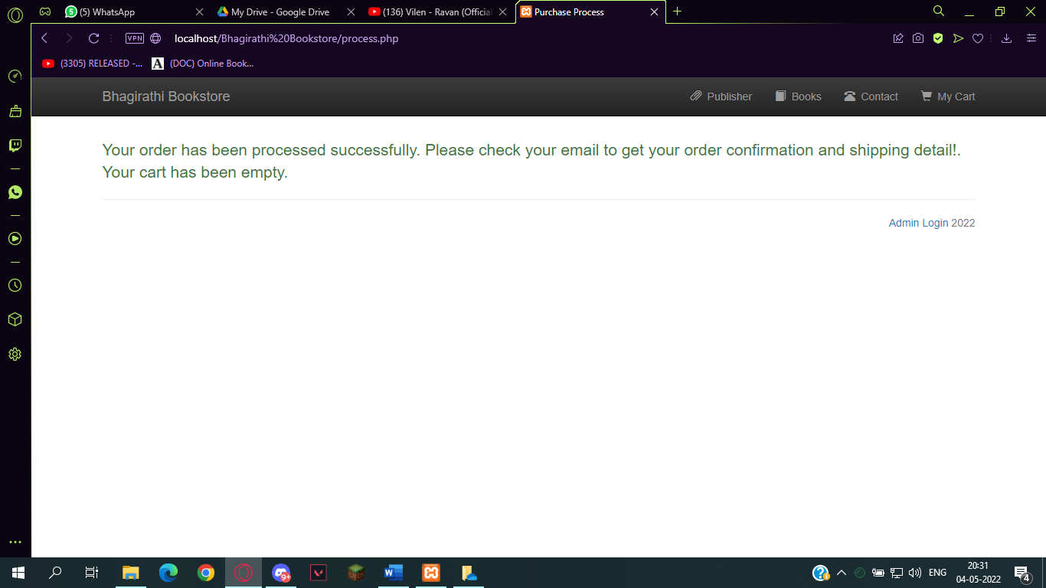

Slide 32
Advantages & Disadvantages
        Advantages:
Cost saving
Time saving
Fast purchasing
View books of all categories
Disadvantages:
Lack of close examination in online shopping.
Lack of touch and feel of merchandise in online shopping.
Frauds in online shopping.

Slide 33
Future scope
The project is prototype and has immense areas of development . The areas of development are as follows:
The web application should be able to remember the preferences of user like remembering his billing and shooping address.
The web application should tie up with the “verified by visa “ and “VerSign” organizations for far more secure transactions.

Slide 34
BIBLIOGRAPHY
The following books were referred during the analysis and execution phase of the project
Books referred:
BEGINNING PHP 5 ---DAVE MERCER
BLACK BOOK HTML ---WILEY DREAMTECH
PHP AND MYSQL WEB DEVELOPMENT -LUKEWELLING,LAURA
MICROSOFT SQL SERVER-2000 --- RANKIN , PAUL & JENSEN
SQL SERVER-2000 ---DAUSAN PETKOVIC
PHP IN A NUTSHELL ---PAUL HUDSON
Websites referred:
http://www.stackoverflow.com

Slide 35
Conclusion
Online Book Store is an online web application where the customer can purchase books online.
Through a web browser the customer can search for a book by its title or author , later can add to the shopping cart and finally purchse the books.

Slide 36

THANK YOU

Slide 37


